Slide 1

Asking Questions

Slide 2

What is the Purpose of Asking Questions?
The purpose of asking questions is to know if you want the job or not. If you have the information you need, it will be easy to decide on an offer.

Slide 3

What is the Value of Asking Questions?
It will show your interest in the job.
It shows you are actively engaged during the interview.
It makes you stand out and they will remember you.
Get important information that will help you decide on the job.

Slide 4

Interviewing Is A Two-Way Street!
“I have many candidates meet with me as the final interview. When I ask them what questions they have, I've too often heard, "Well, everyone else was great and answered them, so I'm good...." These people do not get offers. All candidates should look to get as much perspective for their own due diligence. Additionally, if someone doesn't have an inquiring mind, they're likely not a fit.” –Hiring Manager

Slide 5

Two Opportunities To Ask Questions During an Interview:
➊ After STAR statements
➋ At the end of the interview

Slide 6

What Happens if You Don’t Ask Questions in Your Interview?
You risk being perceived as unprepared or disorganized
You will appear disinterested and lazy. Why would a hiring manager consider you for a job that you don’t seem excited about?
You are less likely to get the job offer.

Slide 7

Mistakes to Avoid When Asking Questions in Your Interview:
Don’t ask basic questions about the company. Show that you have done your research!
Don’t ask questions that are clearly stated in the job description.
Save questions about salary, dress code, and other company policies for after you know the company wants to offer you the job.
Don’t ask “So how did I do?” or “Do you have any feedback for how I did in the interview?”

Slide 8

If An Offer Comes, You Should Know:
The job you will be doing
Technologies you will be using
What is expected of you
What is the growth potential
The team/work environment

Slide 9

How to ask questions DURING the interview:
(Follow up questions after a STAR statement)
2-3 questions after you have answered their question.
Should relate to what the interviewer asked you.
“How often do you change your technologies?”
“What are some of the challenges in this position?”
“What is the largest problem facing your team?”

Slide 10


How To Ask Questions at the End of the Interview:
Ask 2-3 “big picture” questions:
➔ company
➔ position
➔ culture
“What will the first 30 days look like?”
“Can you tell me about the team I’d be working with?”
“How will you evaluate my performance?”
“What is the career path for this position?” “What can you tell me about the position that isn’t in the job description?”

Slide 11
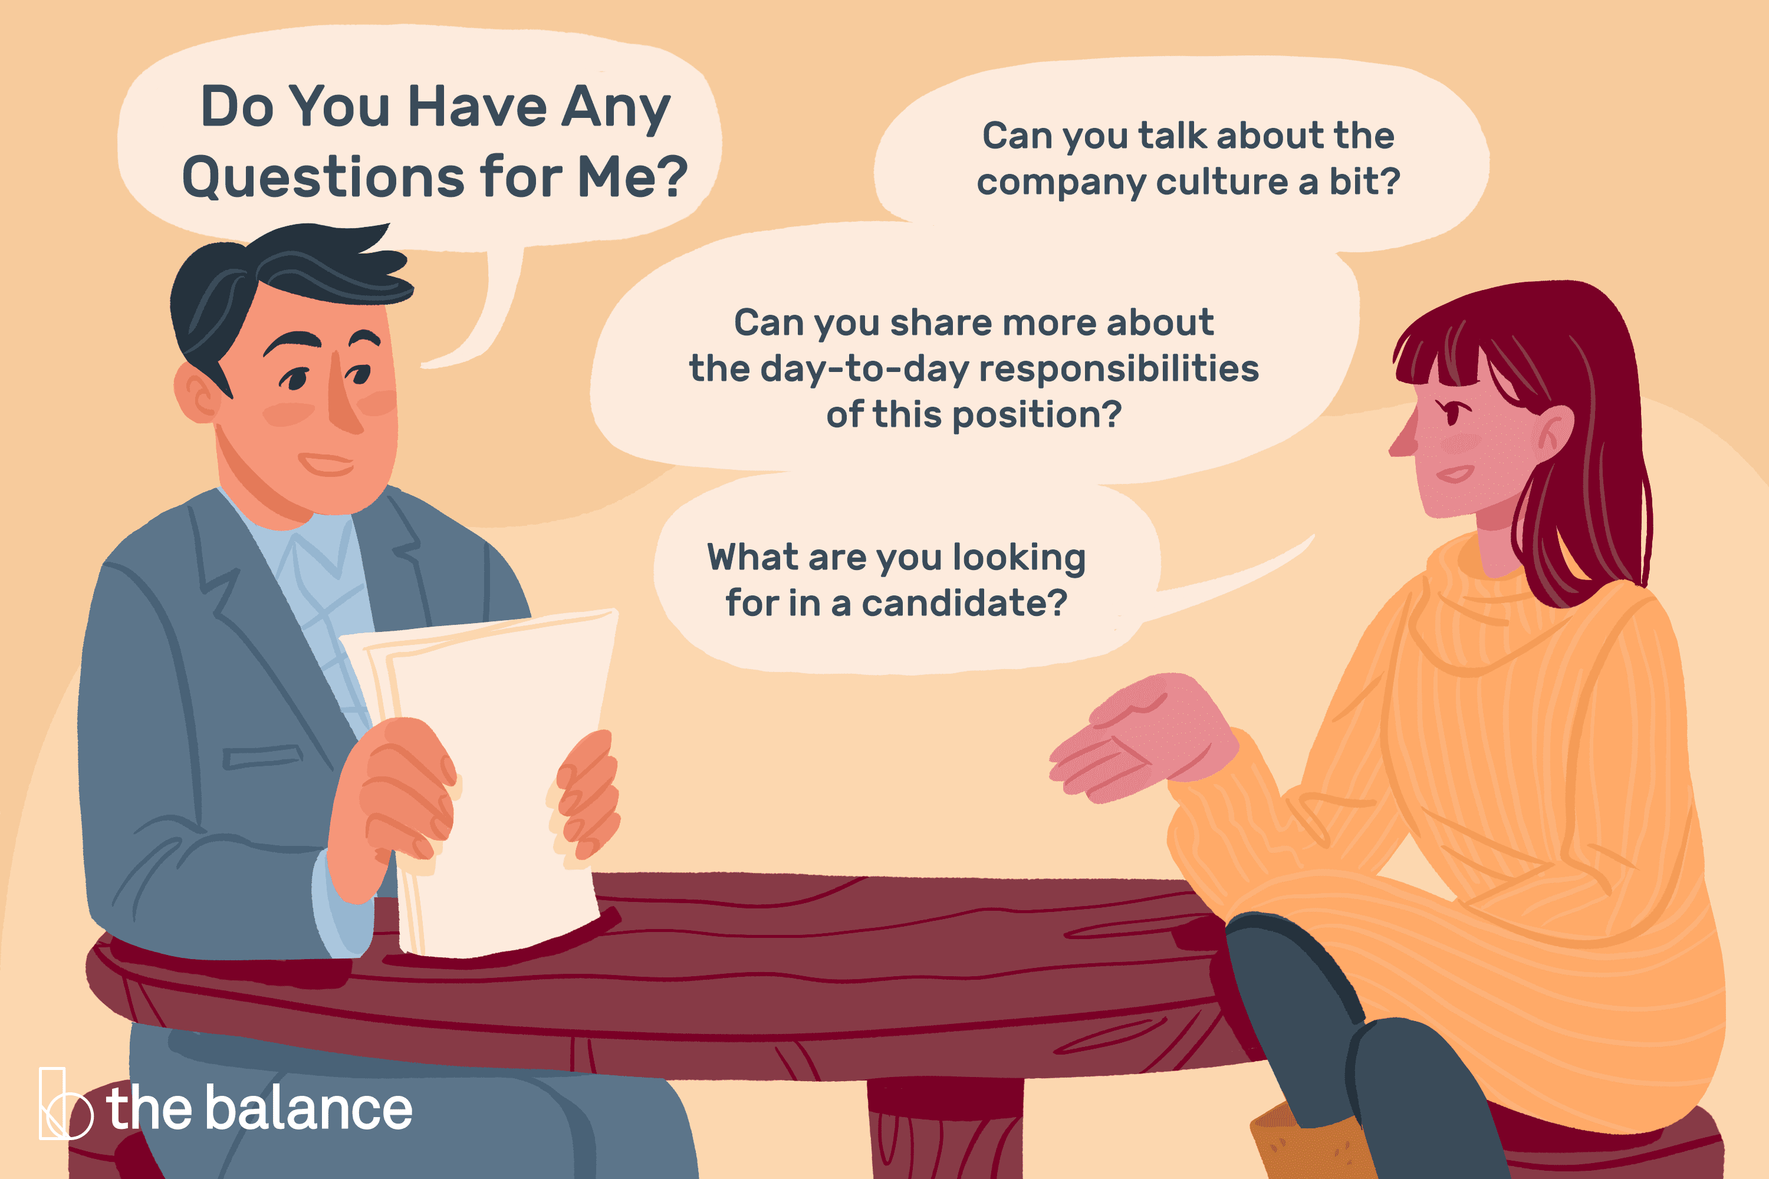

Slide 12

Your goal is to show your interest and get the information you need to decide on an offer. You do this by asking questions at the end of the interview and, if possible, during.

